Slide 1

Addressing SDG (Sustainable Development Goals) 2: Zero Hunger through Crop Recommendation System
By Nathan Mungai and Thomas Duncan

Slide 2

Introduction to SDG 2: Zero Hunger
The UN Sustainable Development Goal 2 (SDG 2) aims to end hunger, achieve food security and improved nutrition, and promote sustainable agriculture by 2030. This goal is crucial as it addresses the fundamental human right to food and seeks to eliminate the root causes of hunger and malnutrition globally.

Slide 3
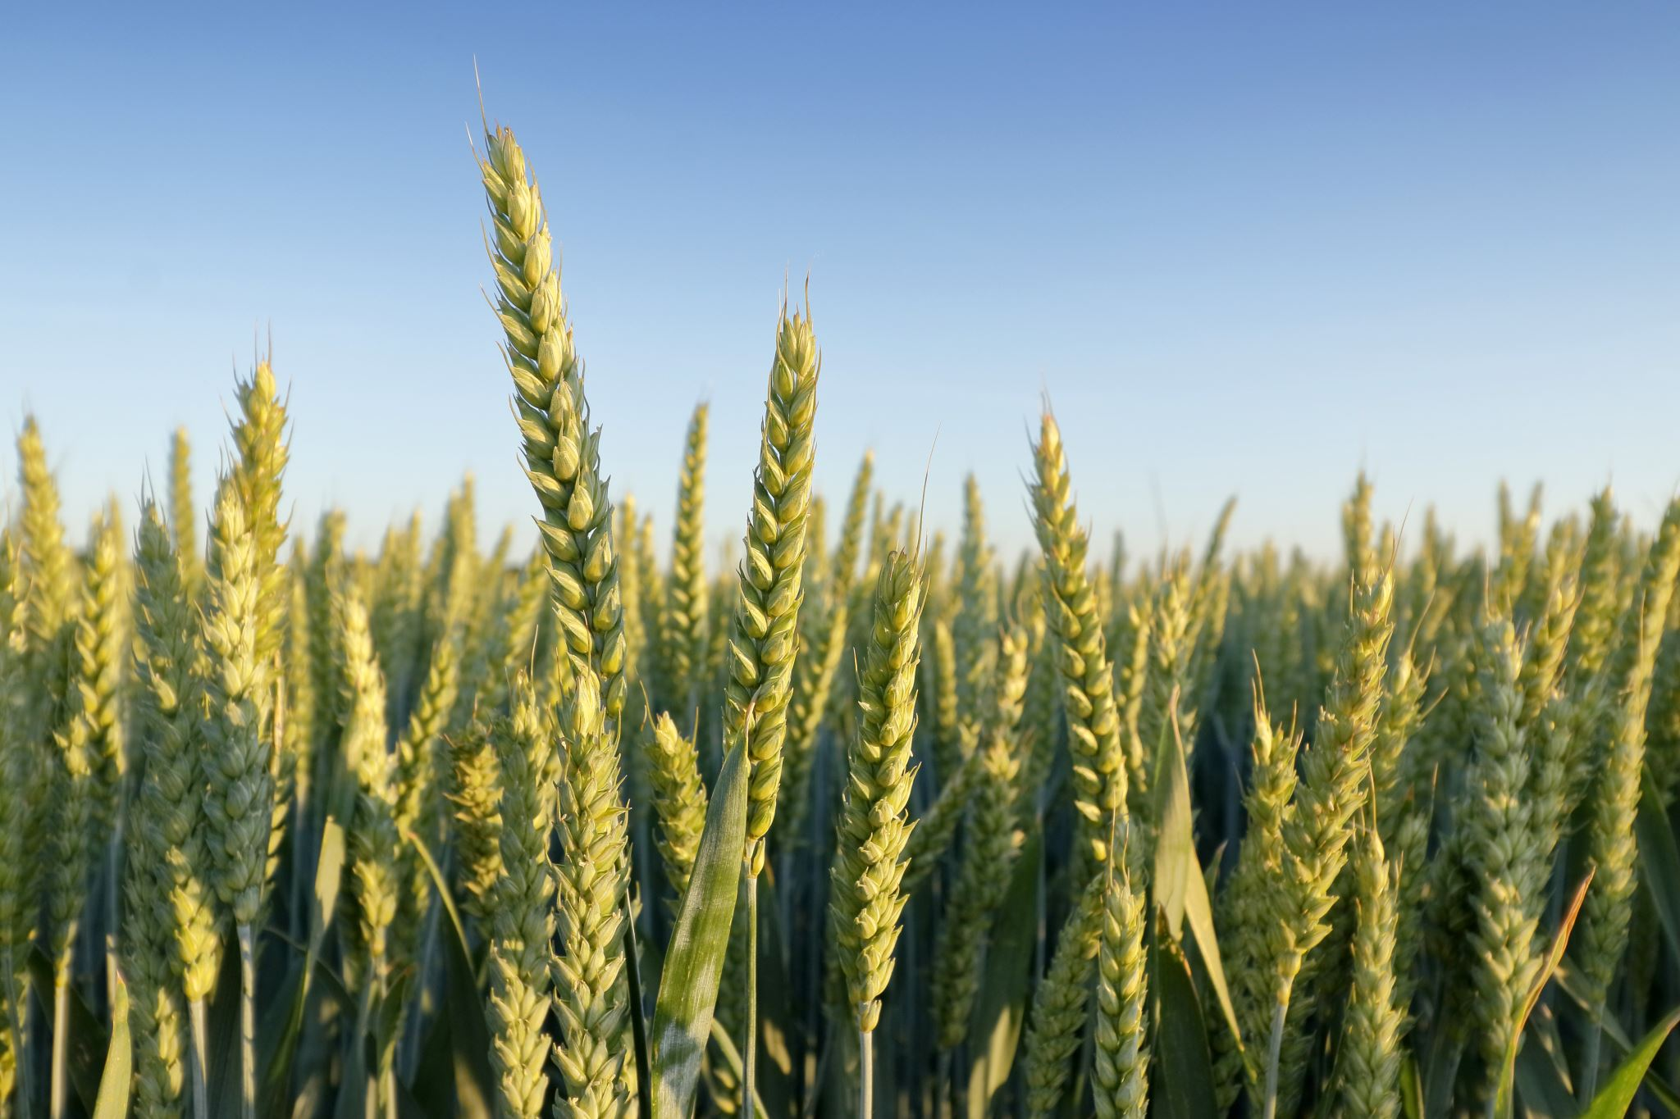
Specific Problem: Unpredictable Crop Yields
One of the major challenges facing farmers, especially in developing regions, is the unpredictability of crop yields. Factors such as climate variability, soil health, and inadequate farming practices contribute to fluctuating crop yields, making it difficult for farmers to plan and manage their resources effectively.

Slide 4
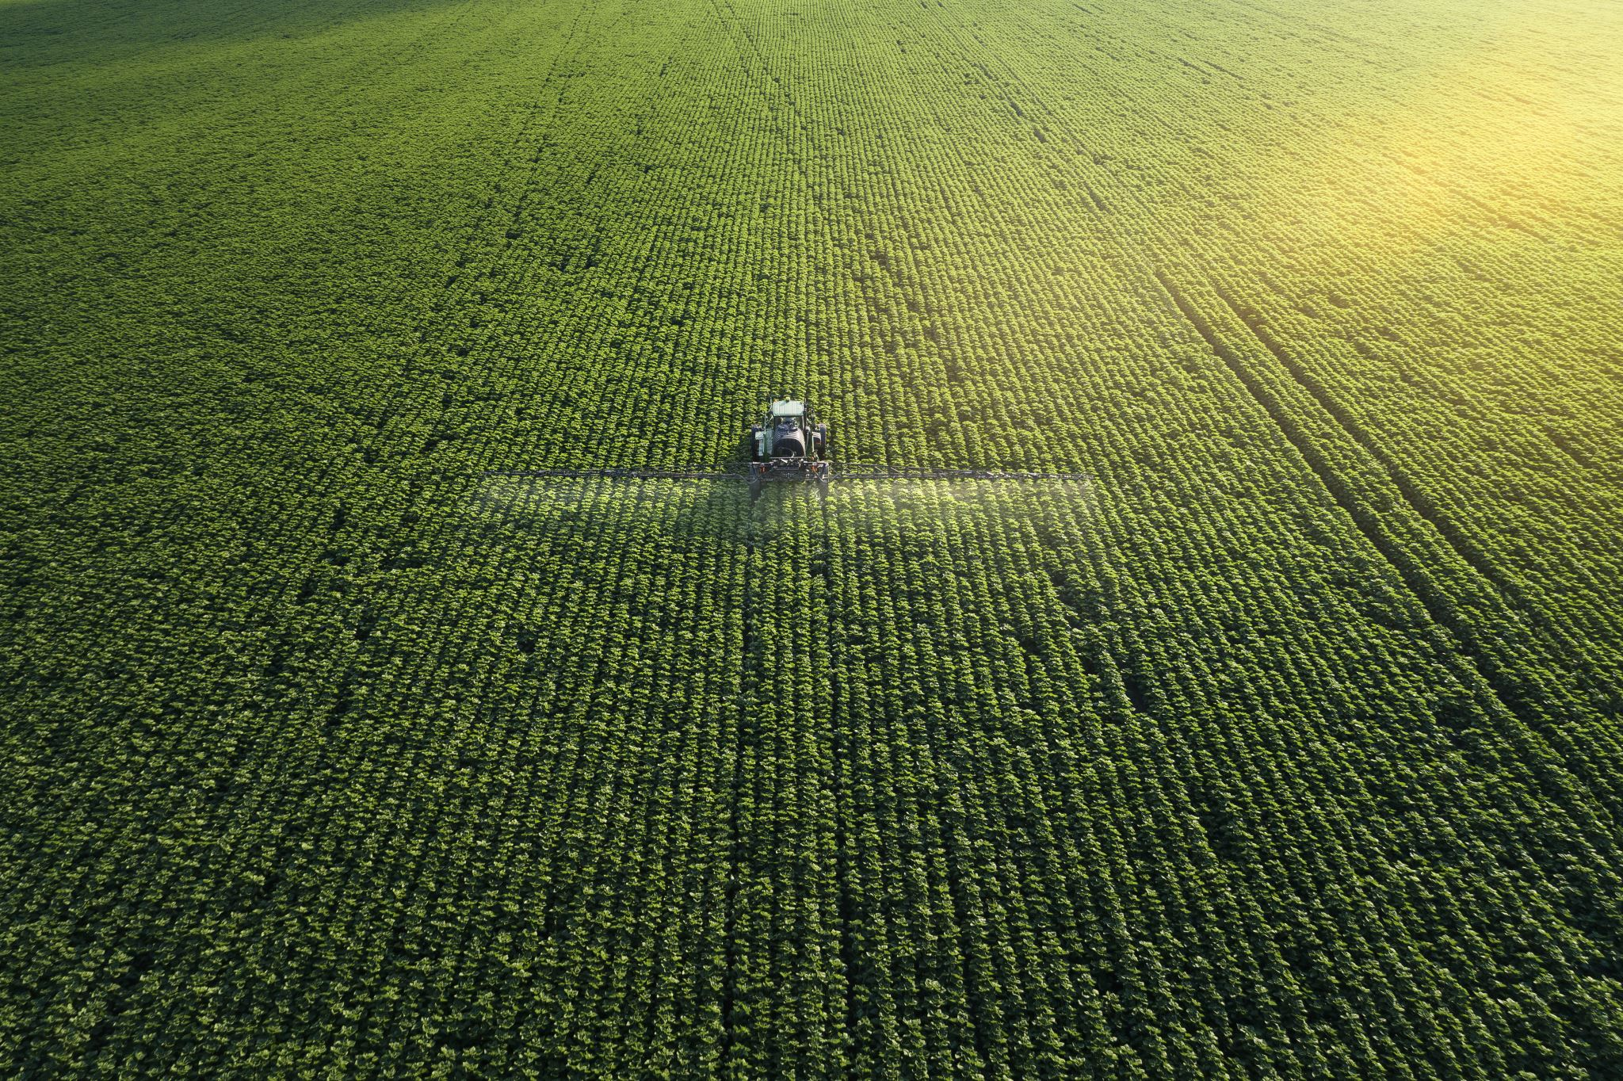
Planned Machine Learning Application: Crop Recommendation System
The primary objective of the Crop Recommendation System is to provide farmers with accurate recommendations on what crops to plant based on various input features such as weather conditions, soil characteristics, and historical crop data.

Slide 5

Data Collection
The system will utilize a variety of data sources to build an accurate and robust recommendation model:
Weather Data: Information on temperature, precipitation, humidity, and other climatic factors.
Soil Data: Soil properties such as nutrient levels, pH, and organic matter content.
Historical Crop Yields: Historical records of crop yields for different regions and crop types.

Slide 6

Machine Learning Model
The recommendation system will employ a Random Forest Classifier to recommend suitable crops. The choice of Random Forest is due to its ability to handle complex interactions between input features and its robustness to overfitting.

Slide 7

Machine Learning Model
1. Data Preprocessing:
- Clean and preprocess the data to handle missing values and normalize feature scales.
2. Model Training:
- Train the Random Forest Classifier using the training dataset.
3. Prediction and Evaluation:
- Use the trained model to recommend crops on the testing dataset.

Slide 8

Implementation Steps
1. Data Collection:
Collect data from various sources including weather APIs, soil databases, and historical crop yield records.
2. Data Preprocessing:
Handle missing values by imputing or removing them.
Normalize the data to ensure consistency.
3. Model Training:
Train the Random Forest Classifier on the pre-processed data.
Evaluate the model’s performance using metrics such as accuracy, precision, and recall.

Slide 9

User Interface
A user-friendly interface will be developed to allow farmers to input their data and receive recommendations. This interface can be in the form of a web application, providing:
Data Input Forms: Fields for farmers to enter information about their location, soil properties, and recent weather conditions.
Recommendation Results: Displaying the recommended crops and providing actionable insights for optimizing farming practices.

Slide 10

Design and Development of Our Crop Recommendation System Introduction Problem Definition
The unpredictability of crop yields due to several factors such as climate variability, soil health, and inadequate farming practices poses a significant challenge to farmers. This unpredictability affects farmers’ incomes and contributes to food insecurity, thus hindering progress towards the UN SDG (Sustainable Development Goals) 2. Our Crop Recommendation System aims to provide recommendations on what crops to plant using machine learning techniques, enabling farmers to make informed decisions, optimize their practices, and increase agricultural productivity.

Slide 11
Objectives
- To recommend crops based on input features such as weather conditions, soil characteristics, and historical crop data.
- To provide actionable recommendations to farmers for optimizing farming practices.
- To contribute to achieving SDG 2: Zero Hunger by enhancing food security and promoting sustainable agriculture.

Slide 12
Machine Learning Techniques Selected Techniques
- Classification: For predicting categorical outcomes (crop types). We have chosen to use the Random Forest Classifier for its robustness and ability to handle complex interactions between input features.
- Data Pre-processing: Standardization and handling of missing values to ensure data quality.
- Cross-Validation: To ensure model robustness and prevent overfitting.

Slide 13

System Architecture
1. Data Collection and Storage: Collecting data from various sources and storing it in a centralized database.
2. Data Pre-processing: Cleaning, normalizing, and preparing the data for model training.
3. Model Training: Training the classification model using the pre-processed data.
4. User Interface: Allowing farmers to input their data and receive predictions and recommendations.
5. Prediction and Recommendation Engine: Using the trained model to make predictions and generate recommendations.

Slide 14

Detailed Architecture
1. Data Collection and Storage:
Database: A relational database to store and manage the collected data. Data was collected from 2 different datasets found on kaggle.
2. Data Pre-processing:
- Cleaning: Removing or imputing missing values.
- Normalization: Standardizing feature scales to ensure consistency.
- Feature Engineering: Creating new features or modifying existing ones to improve model performance.

Slide 15

3. Model Training:
- Algorithm: A Random Forest Classifier was chosen to make predictions on crop yield.
- Training: The model was be trained on the collected data in a 70-30 split.
- Evaluation: The model’s performance was evaluated and got a 98% accuracy score.
4. User Interface Development:
- We developed a basic web application using flask with input forms for farmers to manually enter their data. This can be scaled at a later stage to use IoT sensors.
- Initial recommendations are displayed based on the input data.

Slide 16

Conclusion and Next Steps
The crop yield prediction system is functional, providing accurate predictions through a user-friendly web interface. The following steps are planned for further enhancement:
Model Improvement: Explore advanced models and techniques to improve prediction accuracy.
Big Data Integration: Incorporate larger datasets and use distributed computing frameworks like Apache Spark for scalability.
Prescriptive Analytics: Extend the system to provide actionable recommendations based on predictions.
User Feedback: Collect feedback from potential users (farmers) to refine the user interface and feature set.
IOT integration. Use of IOT devices to read soil and weather data for automatic inputs to the program.

